Slide 1
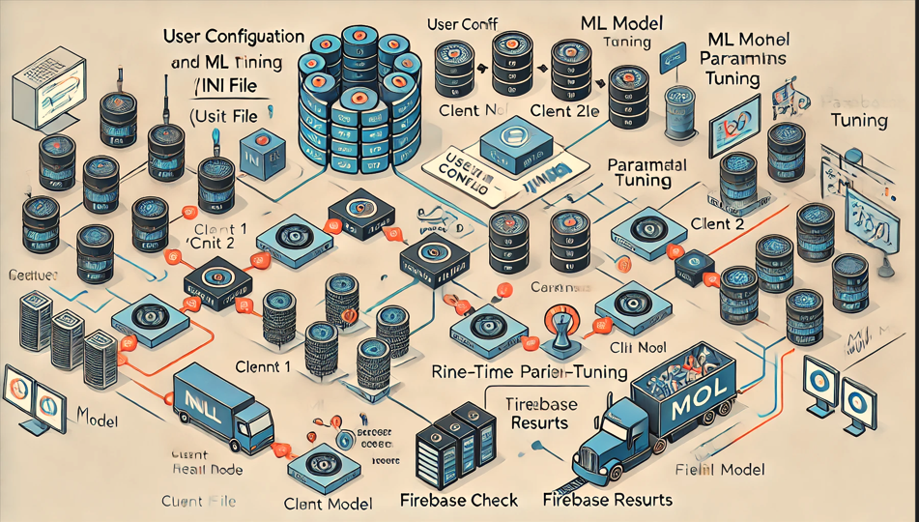
Auto- ML – Framework Name: Guy Yarhi Cycle: DS17 2024

Slide 2
AGENDA
Introduction
Auto ML Framework – Architecture Automation Framework
Workflow and Execution
Development Environment
Job Management and Cloud Integration
System –Flow Diagram
Summary

Slide 3
Introduction

Slide 4
Abstract This project involves developing an Automated Random Forest Ensemble Framework The framework automates the process of training, testing, and validating machine learning models, specifically using Random Forest and ensemble methods for smaller data groups. The automation framework is designed to run until a specified error rate is achieved, ensuring optimal model performance. Key components include: Configuration Management: Using INI files to set hyperparameters and other configurations. Task Management: Utilizing joblib to split tasks and manage parallel processing. Data Handling: Loading and processing data from CSV or PKL files. Model Training: Implementing Random Forest and ensemble methods to train models. Error Handling: Continuously running the workflow until the desired error rate is met. Cloud Integration: Storing data and results in Firebase Realtime Database for easy access and collaboration.

Slide 5
Auto ML Framework – Architecture & Flow

Slide 6
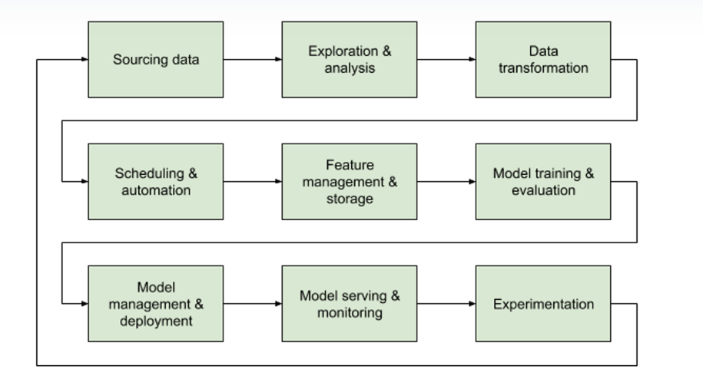
Auto ML Framework – Architecture
Typical flow:

Slide 7
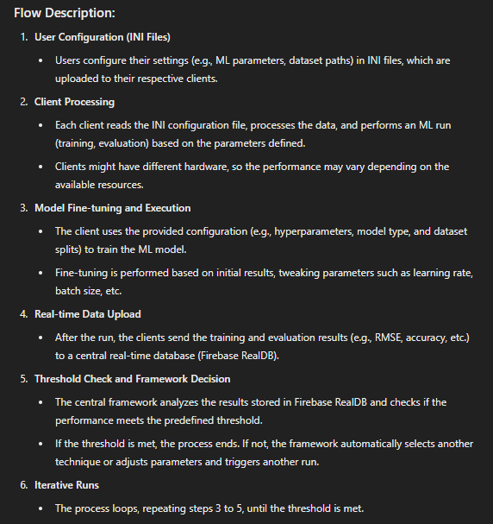
Auto ML Framework – Flow

Slide 8
Environment Development

Slide 9
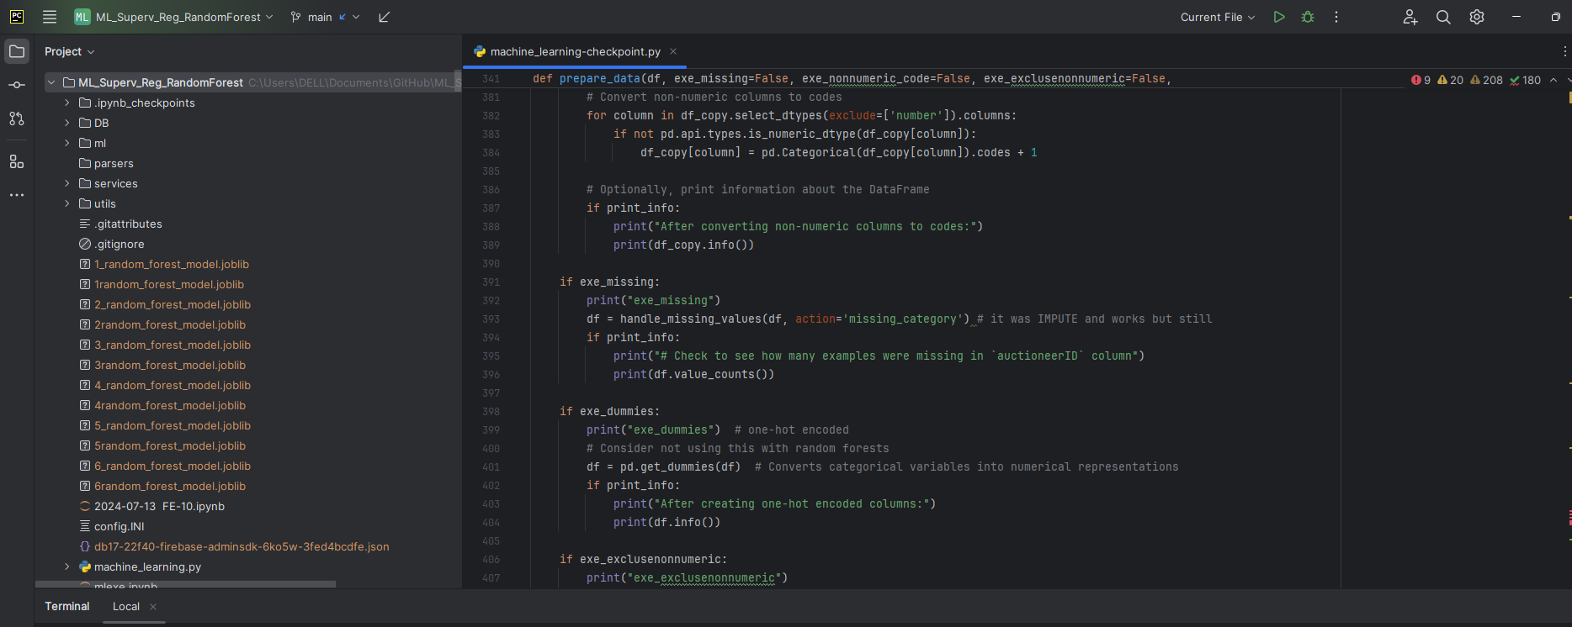
Development IDE - Pycharm

Slide 10
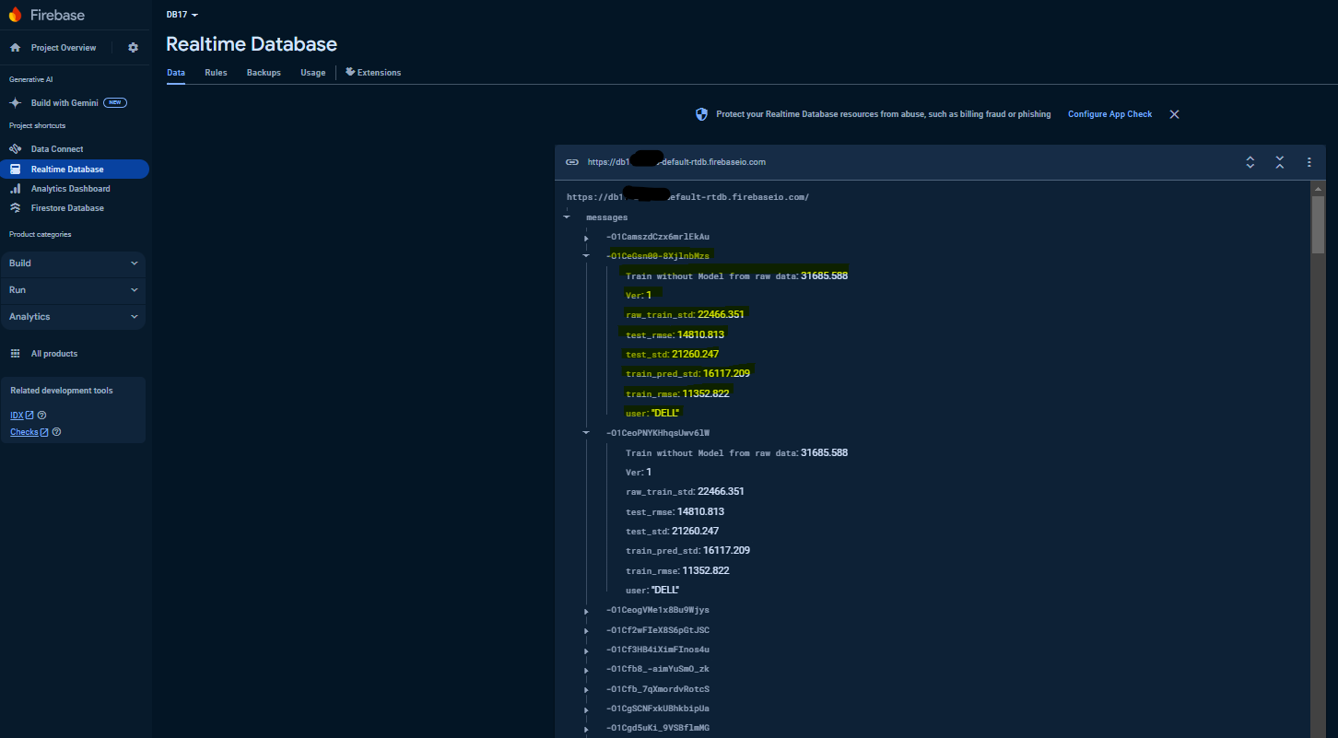
Development IDE – Google Cloud service - Firebase
A system where multiple users can run machine learning (ML) training cycles, each with their own set of parameters and results. The results are stored in a message queue, and each message contains detailed metrics from the training process.

Slide 11
Google Cloud service - Firebase

Slide 12
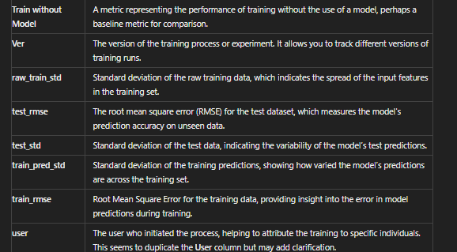
Customization – Google Cloud service - Firebase
Custom messages from customer ML sessions:

Slide 13
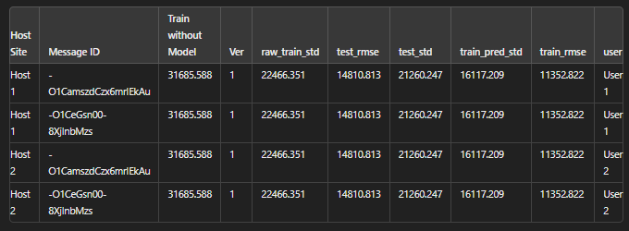
Customization – Google Cloud service - Firebase
messages from customer’s (same company client) sites on their ML sessions:

Slide 14
System - Flow Diagram

Slide 15
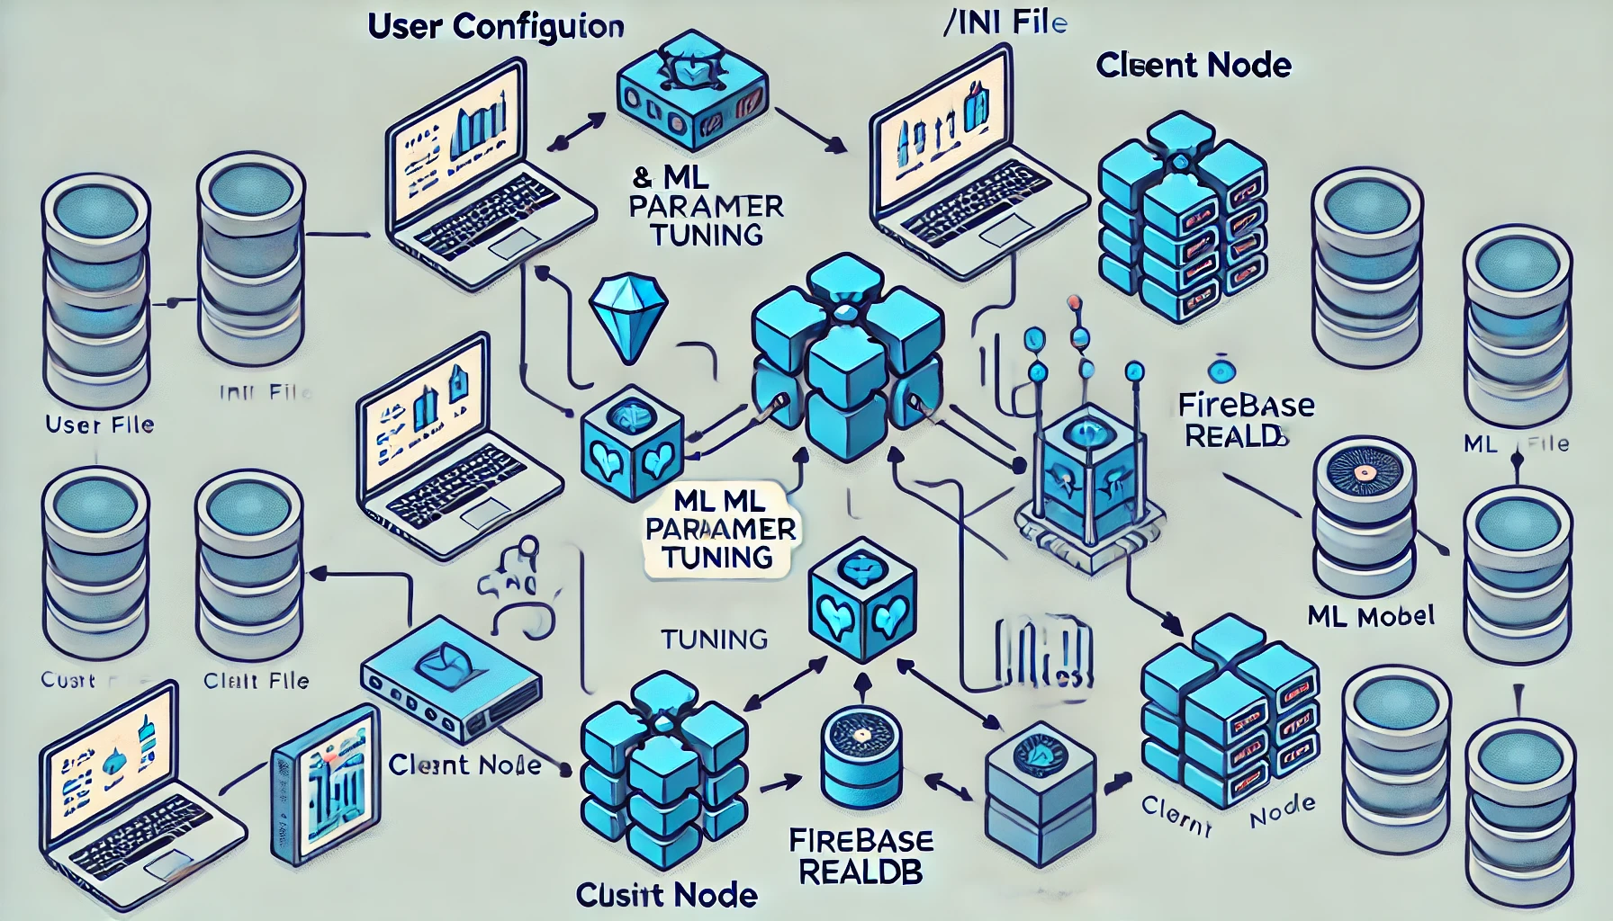
Flow Diagram:
Flow Diagram Description:
INI Configuration: Represented as the first block where users define their configurations.
Client: Each client has its own hardware setup (depicted by distinct client nodes). Each client reads the configuration, processes the data, and runs the ML model.
Fine-Tuning: Shown as an iterative loop within the client block, where the parameters are adjusted.
Real-Time Firebase Upload: The clients upload their results to Firebase RealDB (central node).
Threshold Check: A decision node where the results are evaluated. (TBD- Under DEV)
If the threshold is achieved, the process ends (success path).
If not, the framework adjusts parameters and triggers another run, leading back to the client processing step.

Slide 16
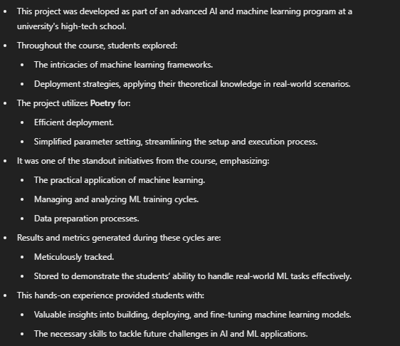
Summary

Slide 17
THANK YOU

